Slide 1




WELCOME

Slide 2

DAY
02
Control Statements

Slide 3
TABLE OF CONTENTS
01
The for Loop
04
switch statement
02
The while Loop
05
break and
continue
03
The do-while Loop

Slide 4

01
The for Loop
“for loop” is an entry-controlled loop, which means that the condition is checked before the loop’s body executes.
Main Use: To loop through a block of code a specific number of times

Slide 5
Syntax
for (initialization; condition; updation) {
// body of for loop
}
Initialization: Initialize the variable to some initial value
Test Condition: Defines the condition for loop to run. If the condition is true, then the body of loop is executed. If evaluated false, loop is terminated.
Update Expression: After the execution loop’s body, it Increments/ Decrements a value.
Body of Loop: Statements to repeat. Enlosed inside {} braces.

Slide 6
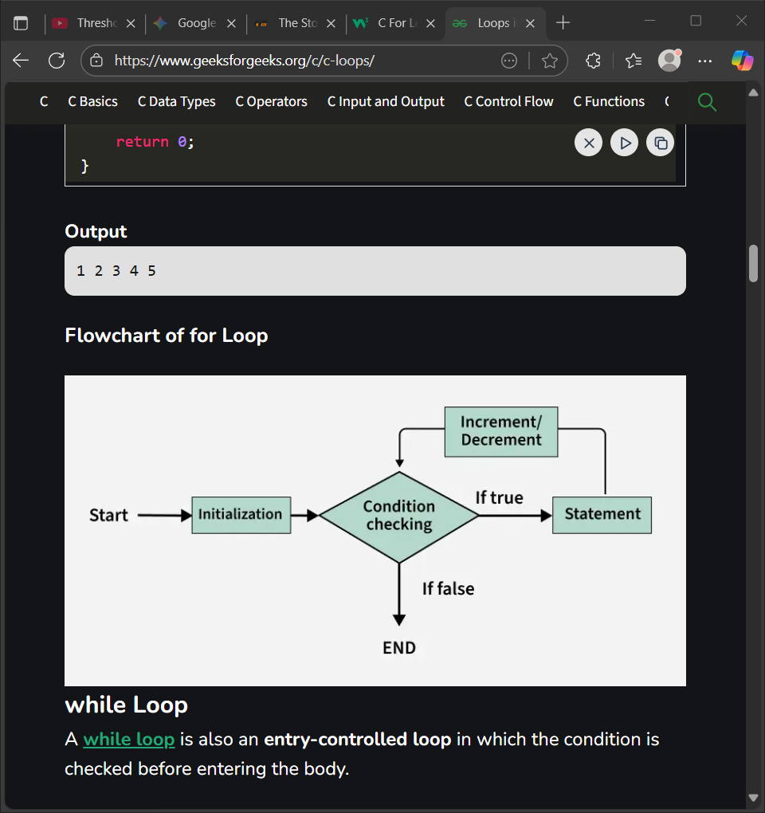
ILLUSTRATIONS

Slide 7
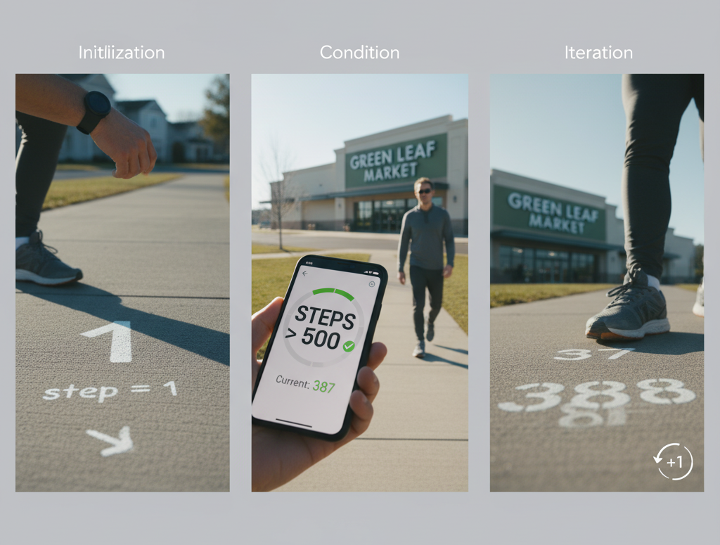
ILLUSTRATIONS

Slide 8

IT’S YOUR TURN

Slide 9
The while Loop
02
A “while loop” is also an entry-controlled loop in which the condition is checked before entering the body.
Purpose: To execute a block of code as long as a specified condition is true.

Slide 10
Syntax
while (condition) {
// code block to be executed
}

Slide 11
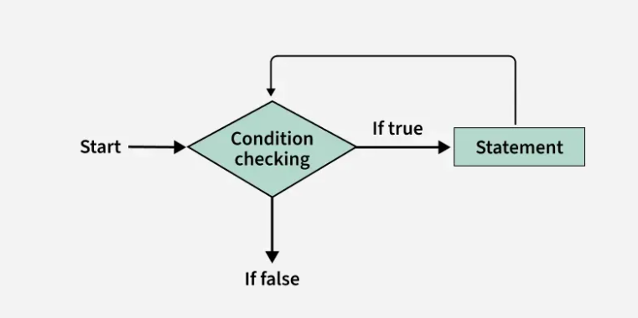
ILLUSTRATIONS

Slide 12
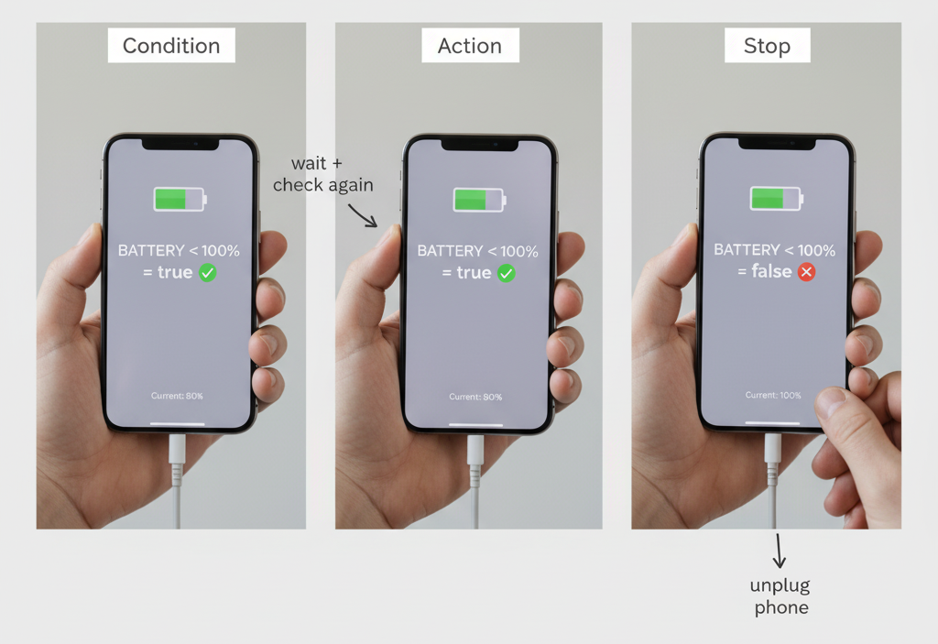
ILLUSTRATIONS

Slide 13
IT’S YOUR TURN

Slide 14
03
The do-while Loop
The “do-while loop” is an exit-controlled loop in which the condition is checked after executing the loop body.

Slide 15
Syntax
do {
// code block to be executed
}
while (condition);
This loop will execute the code block once, before checking if the condition is true, then it will repeat the loop as long as the condition is true.

Slide 16
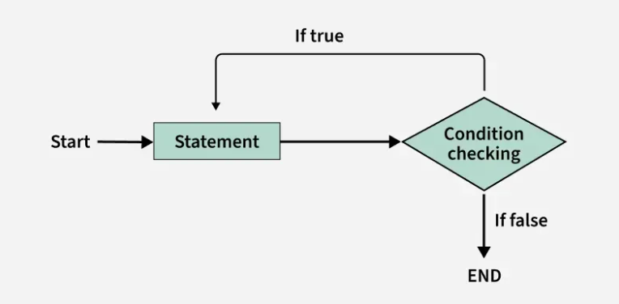
ILLUSTRATIONS

Slide 17
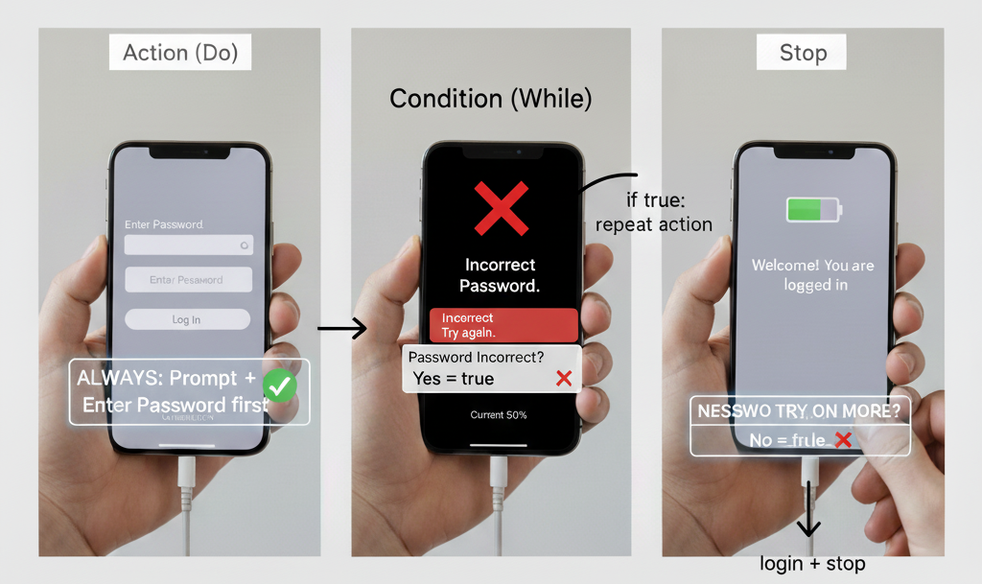
ILLUSTRATIONS

Slide 18
IT’S YOUR TURN

Slide 19
04
Switch statement
“switch statement” is a conditional statement that allows you to execute different code blocks based on the value of a variable or an expression.

Slide 20
Syntax
switch (expression) {
case value1:
// Code_block1
break;
case value2:
// Code_block2
break;
default:
// Default_code_block
}

Slide 21
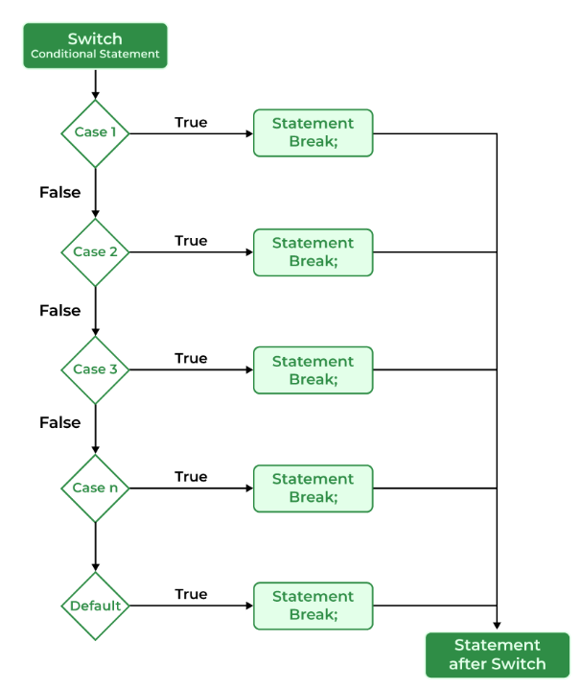
ILLUSTRATIONS

Slide 22
IT’S YOUR TURN

Slide 23

05
break
The “break” statement in C is a loop control statement that breaks out of the loop when encountered.

Slide 24
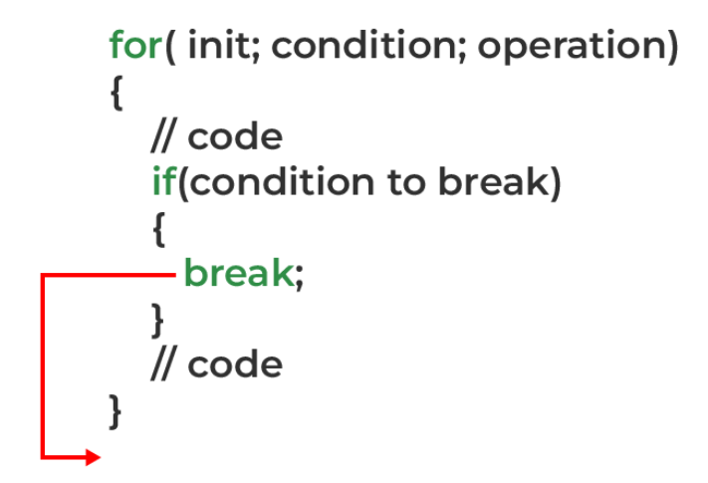
Syntax
// in a block {
break;
}

Slide 25
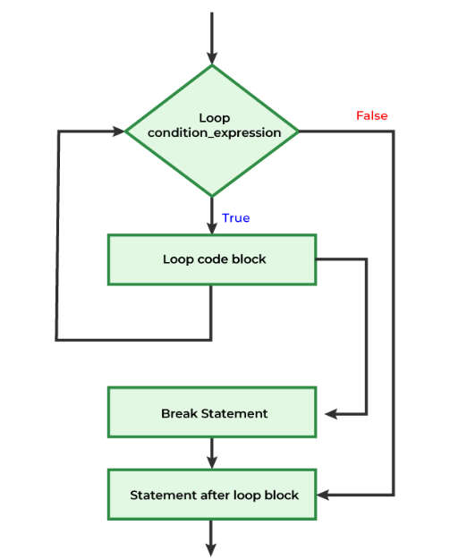
ILLUSTRATIONS

Slide 26
05
continue
The “continue” statement in C is a jump statement used to skip the current iteration of a loop and continue with the next iteration.
Continue can only be used in loops.

Slide 27
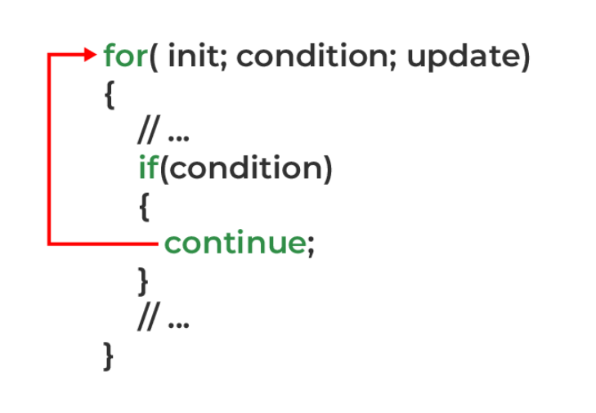
Syntax
continue;

Slide 28
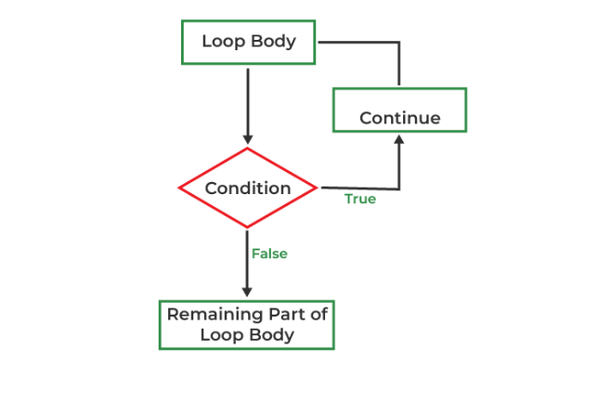
ILLUSTRATIONS

Slide 29
IT’S YOUR TURN

Slide 30



TIPS
Ask yourself: "What is the starting point? What is the stopping condition? How does the value change with each step?"
LOGIC
Stuck on a problem? Explaining it to someone often reveals the solution. Collaborate to find new perspectives.
DISCUSS
Master control statements with practice: start simple, tackle bigger challenges, and break down complex problems.
SOLVE

Slide 31
“Learning to code is learning to create. Loops and conditions are your first tools for building worlds, one logical step at a time."

Slide 32

THANK YOU!

Slide 33


OUR MENTORS
YOUR NAME
YOUR NAME

Slide 34
RECAP
The for Loop
switch statement
The while Loop
break and continue
The do-while Loop

